Slide 1
Types of Questions!
RE: reading test 2018-2019, wnj

Slide 2
Different types
Multiple choice
Yes/no
True/false
Tick the boxes
Open

Slide 3
Multiple choice (1/5)
A) most important words
B) search in text
C) what’s your answer
D) see if your answer (or something which resembles it) is there

Slide 4
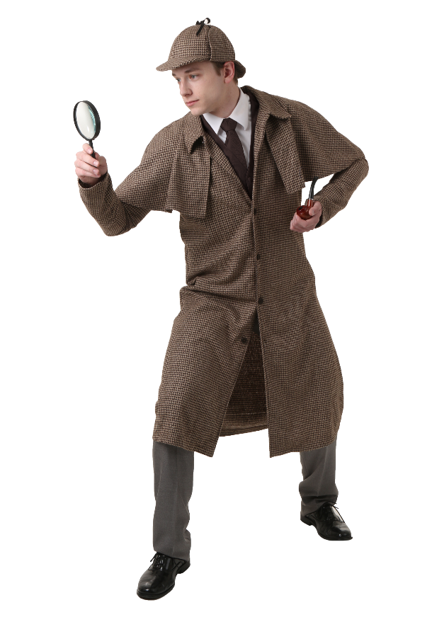
Multiple choice (2/5)
Sherlock Holmes method:
“When you have excluded the impossible, whatever remains, however improbable, must be the truth.”
“it’s not A, B or C. So it must be D!”

Slide 5
Multiple choice (3/5)
I am writing to complain about the pair of jeans I bought from your catalogue on 3 October 2011. I was very disappointed when they arrived.
First of all, I should state that I am unhappy with the quality of the delivered product, despite claims of the top-quality goods in your catalogue. In addition to the fact that you delivered the wrong size and in a colour which I had not chosen, I also found out that the zipper was broken.
Secondly, I must say a few words about your careless attitude to your customers. Your company promises a free T-shirt for every pair of jeans a customer orders. But I did not receive one. You guaranteed delivery without delay. However I had to wait for my order for two weeks.
To resolve the problem I would like your help in getting a full refund. Please contact me at the above address.
VRAAG: Wat was er niet mis met de spijkerbroek?

Slide 6
Multiple choice (4/5)
Wat was er niet mis met de spijkerbroek?
Kleur
Maat
model

Slide 7
Multiple choice 5/5
I am writing to complain about the pair of jeans I bought from your catalogue on 3 October 2011. I was very disappointed when they arrived.
First of all, I should state that I am unhappy with the quality of the delivered product, despite claims of the top-quality goods in your catalogue. In addition to the fact that you delivered the wrong size and in a colour which I had not chosen, I also found out that the zipper was broken.
Secondly, I must say a few words about your careless attitude to your customers. Your company promises a free T-shirt for every pair of jeans a customer orders. But I did not receive one. You guaranteed delivery without delay. However I had to wait for my order for two weeks.
To resolve the problem I would like your help in getting a full refund. Please contact me at the above address.

Slide 8
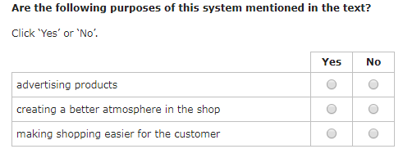
Yes/no
Find the most important words in the answers and then in the text

Slide 9
True/false (1/2)
Find the most important word in the answer and then in the text

Slide 10
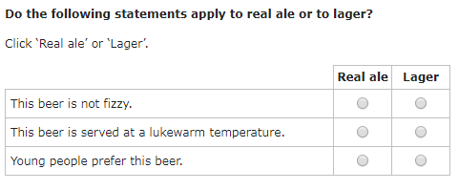
True/ false (2/2)
This is a different kind of True /False
One word can change the correct answer!

Slide 11
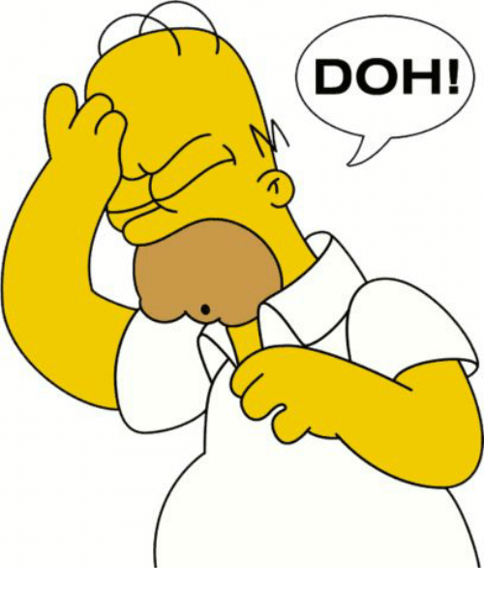
Tick the boxes
Whoops!

Slide 12
Open questions
There are no open questions in the test!

Slide 13
Positive/negative method
If you don’t know the answer you can also use the positive/negative method:
How does Brad feel about his wife?
He likes her a lot
He does not like her
He hates her
He wants to murder her with a breadknife.
You read the text and know if Brad was positive or negative about his wife.
Choose the POSITIVE answer

Slide 14
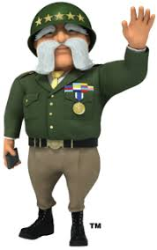
General tips
Use reading strategies
Read important words from the question/answers
Find those words in the text
What is your answer?
See if your answer is there

